Slide 1
Machine Learning

Slide 2
Why Machine Learning
In order to make statement about the future by using machines
Done the job by using the available data
Eg: Heart beat monitor smart watches, Product recommendation

Slide 3
Types of learning
Supervised learning
Unsupervised learning
Reinforcement learning
Outputs are specific
Outputs are not specific
Learning from the environment by doing mistakes

Slide 4
Supervised Learning
Regression
Linear regression
Eg: salary prediction (usually numeric type)
Classification
Logistic regression
Eg: binary and Multi class classifications
Outputs are continuous
Outputs are discrete
Poverty classification

Slide 5
Model Development
Collection of data
Business understanding
Data Pre-processing
Model building
Model training
Model testing
Model evaluation
Model optimization

Slide 6
Data-Preprocessing
Data Cleaning
→ Dropna, mean, median, mode computation, replace
Most of the time, Null data is dropped (because the client himself doesn’t have the clarity about the data)
Sometime, the null value is replaced with mean, mode repetition (if there is large number of repetition or less number of null values)
Data transformation
If data is continous– standardization/normalization, Minmax scalar
If data is discrete – Label encoding, one hot encoding
Data type conversion –i.e., from object to int or float etc.

Slide 7
Data transformation techniques
Need
Data has input values with differing scales.
Variables that are measured at different scales do not contribute equally for the model development, hence we go for standardizing the model
Standardization assumes that our observations fallows normal distribution (bell- shaped curve)
Standardscaler (μ=0, σ=1)
makes the mean as zero and standard deviation as one.
can be influenced by outliers (if they exist in the dataset) since it involves the estimation of the empirical mean and standard deviation of each feature
Z=(x- μ)/ σ

Slide 8
MinMaxScaler
scales all the data features in the range [0, 1] or else in the range [-1, 1] if there are negative values in the dataset
m = (x -x_{min}) / (x_{max} -x_{min})
Robust scalar
This scaler removes the median and scales the data according to the inter quantile range by considering first and third quartiles
It is used when the data have outliers
Goal – The main purpose of scaling is to improve training time and to control outlier

Slide 9
Parametric models
Comes up with assumptions
Types
Linear regression
Logistic regression
Regularization technique
Ridge regression
Lasso Regression
Elastic Net Regression
Non- parametric models
No need of any assumptions
Types
Decision tree
Random forest
Gradient boosting
Support vector machines
Neural vectors

Slide 10
Linear regression
Simple Linear regression
→There is only one independent inputs are available to predict the output
→ y =mx+c
→ Experience vs Salary
Multi-linear regression
→ There is more than one independent features available to predict the output
→y=m1x1+m2x2+…….+c
→Experience, location vs Salary

Slide 11
Phases in linear regression
Training phase
Known parameter – x,y
Testing phase
Known parameter – m,c
Unknown parameter – m,c
Unknown parameter – y predicted
m- slope of a best fit line
c-intercept, when x=0, the value of y is c

Slide 12
Assumption – Linear Regression
Linearity
x is proportional or inversely proportional to y
Scatterplot, regplot, correlation matrix
Multi collinearity
Auto regression
The parameters should not be influenced by the time
Homo
scadacity
Zero residual mean
No dependency between input features
Should have same variance
All the points should fall on the best fit line
Cook’s distance gives the presence of outliers

Slide 13
Regularization technique for parametric model
Helps to reduce overfitting problem in regression type of problem.
Overfitting
Less bias – less error for train data & High variance – more error for test data
Reason – steep slope (within 1 unit change in X axis, there is a huge movement in Y axis)
Types
Ridge Regression(L2)
Cost function = ∑(y_{a}-y_{p})²/n +λ*(slope)²
The steep slope can be reduced by tweaking learning rate(λ) and slope – CF decreases and hence slope decreases therefore error also gets decreased
Some unimportant features are gets eliminated
Because of introduction λ and slope, train error increases but test accuracy increases

Slide 14
Lasso Regression (L1)
Cost function = ∑(y_{a}-y_{p})²/n +λ*(slope)²
Negative slope is equated to zero, here instead of squaring slope, modulus is used
Due to this, coefficients with negative slope gets eliminated and hence training time increases
Elastic Net Regression
Combo of Ridge and Lasso regression

Slide 15
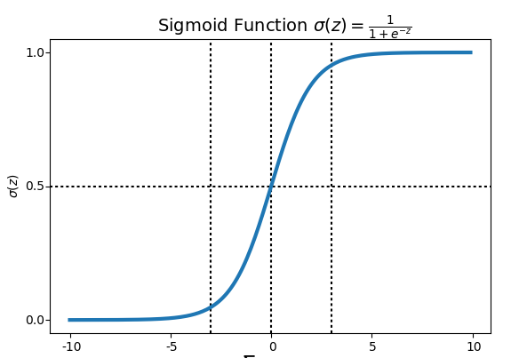
Logistic Regression
Used for classification problem
Exact transformation of linear regression
Sigmoid curve – 1/(1+e^-y), y=mx+c
The value lies between 0 to 1 (based on probability)
Default threshold – 50%
If, p<50% - No
If, p>50% - Yes

Slide 16
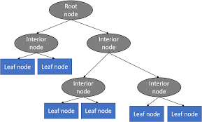
Decision tree
Comes under Non parametric models
Can be used for both regression and classification problems
Simply comes up with if else condition
Techniques for splitting tree
ID3 – Categorical data
C.4.5 – Numerical and Categorical data
CART – Numerical and Categorical data
Root Node
The one feature which contribute more for the output
Edges
The division under the root node where the decisions are impure
Leaf Node
The pure or finalized decision

Slide 17
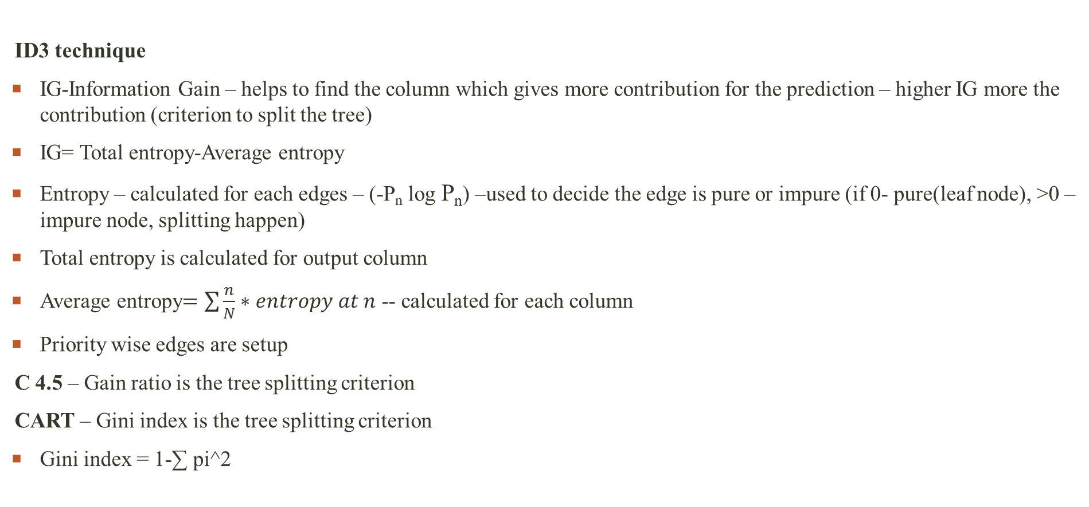
ID3 technique
IG-Information Gain – helps to find the column which gives more contribution for the prediction – higher IG more the contribution (criterion to split the tree)
IG= Total entropy-Average entropy
Entropy – calculated for each edges – (-P_{n} log P_{n}) –used to decide the edge is pure or impure (if 0- pure(leaf node), >0 – impure node, splitting happen)
Total entropy is calculated for output column
Average entropy$=\sum{\frac{n}{N}∗entropy at n}$ -- calculated for each column
Priority wise edges are setup
C 4.5 – Gain ratio is the tree splitting criterion
CART – Gini index is the tree splitting criterion
Gini index = 1-∑ pi^2

Slide 18
Ensemble technique
Overfitting – Less bias ( very less error point in train data)
- higher variance (higher error in test data)
Reason – the model memorizes the pattern, it won’t learn it
Underfitting - More bias ( More error point in train data)
- Lesser variance (lesser error in test data)
Practically it won’t occur
Generalized model – Less bias and lesser variance – practically preferred model
To overcome overfitting, ensemble techniques are used.
Concept-Relay on multiple trees gives more accuracy

Slide 19
Ensemble technique
Bagging
→ Random forest
Increases stability
Boosting
→ Ada boosting
→ Gradient boosting
→ Extreme Gradient boosting
→ Light gradient boosting
→ Cart gradient boosting
Increases accuracy
Stacking
Combination of different algorithm

Slide 20
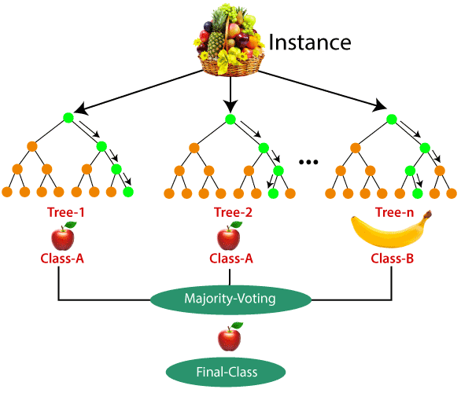
Random Forest
In random forest, we take multiple decision trees and they are constructed parallelly and final decision is made by voting classifier.
Advantage over DT
It increases stability – replying on multiple trees
It reduces variance – reduces test error
Handle overfitting problem
Parallel classifier
Types of sampling
1. Sampling with replacement – All the DT have equal opportunity to pickup the feature
- more stable and accurate, records are repeated
2. Sampling without replacement – All the DT doesn’t have equal opportunity to pickup the sample, takes unique record

Slide 21
Boosting
In boosting technique, DT is constructed sequentially
Here, the DT is constructed by giving more weightage to the error points inorder to increase the accuracy
Advantage
Sequential classifier
Increases accuracy
Note
Sometimes, it may tend to overfitting

Slide 22
Stacking
Stacking combines multiple algorithm like Decision tree, Logistic Regression, Support vector machines etc and by using voting classifier, decisions are made.
Combining all the algorithm for deployment is not a good approach because every algorithm comes with different assumptions and computation.

Slide 23
GridSearchCV
The parameters required for the construction of tree/algorithm are called as Hyper parameters
E.g. estimator, max depth, max leaf split, criterion etc..
If we tweak this parameter, it would give better a result.
Rather than trying all the parameter every time manually, we can take all the parameter and it is passed to the GridsearchCV, it would gives us the better parameter that is needed to be taken.

Slide 24
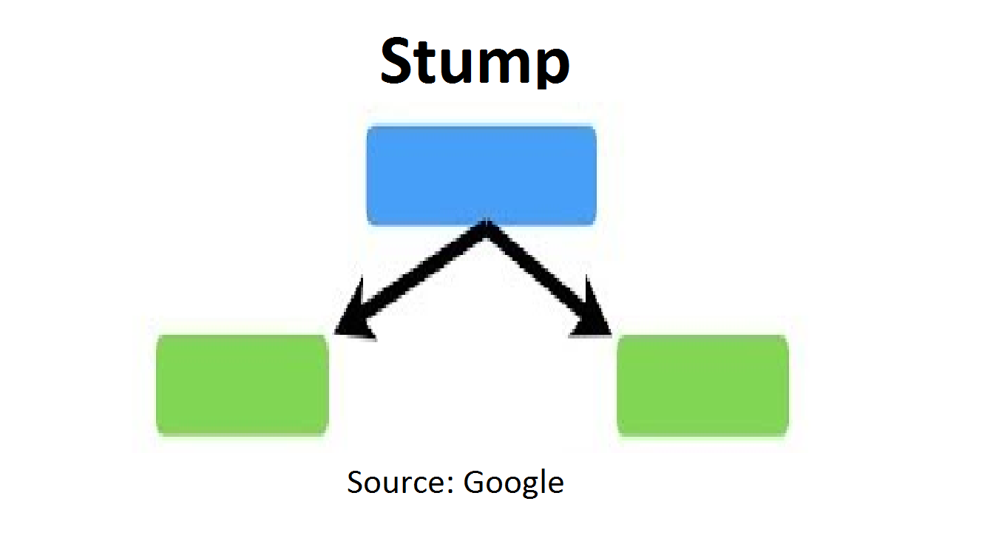
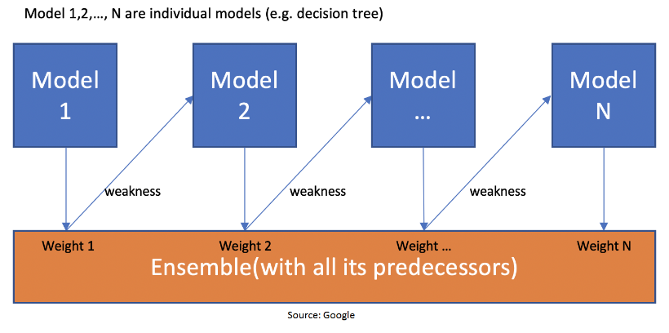
Adaboosting
Developed in 1996
Characteristics
It comes under ensemble techniques
It helps to improve the accuracy of Decision tree
It is the sequential classifier – have dependency between models
Except for the first, from 2nd onwards, trees are grown by updating or learning mistakes from the prior on
Here it has stumps, 1 root node, 2 leaves (trees are not fully grown, max depth is one)
No equal weightage – weak learners have high weightage
Drawbacks
Doesn’t handle noisy dataset (affected by outliers- max dept=1)
Overfitting problem

Slide 25

Steps
Assigns equal weight for all the data
Calculate the error
Calculate the performance of 1st Decision tree
Update the weights
For correctly classified data points - New Weight = Sample Weight * e^(Performance)
For incorrectly classified data points – New Weight = Sample Weight * e^- (Performance)
5. Normalizing the weights - ∑W = 1
6. Construct DT2 and iterate the process until the number of tree mentioned

Slide 26
Gradient Boosting
Developed in 2001
Learning happens by optimizing the loss function. i.e., decreasing the loss/error
Loss functions – mes, rmes, mae
Uses two types of estimator – average types model, DT with full depth
Steps – Gradient boosting regression
Creating base model - Calculate the average of output feature (avg pred value)
Calculating the residuals R1(new target)– actual output value – average output value
Next, DT is constructed by taking residuals as the input feature
Predicted residual values are taken from the DT (RM1 predicted) – less than previous residuals
Calculate new predicted target value – avg pred value + (learning rate* predicted residuals)
Calculate residual R2 = avg pred value – new predicted target value
And repeat the iteration up to the given number of estimator

Slide 27
Steps – Gradient boosting classifier
Calculate log odds/ odd’s ratio x= ln(pi/1-pi) – where pi – probability of success
Compute probability(δ)= 1/(1+e^-x) – Base models
Calculate residuals(R1)=actual-predicted, actual value No=0,Yes=1, predicted = Base model
Construct DT, by taking residuals as an input
DT pred probability
Weight of node(RM1)=∑residuals/(∑pre.prob(1-pre.prob)
Pred log odds x1=(R1-L.R(RM1))
Calculate pred probability = 1/(1+e^-x1)
Repeat the iterations based on the number of estimators
If probability is < 0.5 – No
> 0.5 - Yes
Drawback
Computational space and processing time is more because the DT is grown to a full depth

Slide 28
Avg model
Calculate residuals
(R1)
Predicted residual value- RM1
New predicted target value 2
Residuals R2
Iteration continues
Construction of DT
Regression
Log odds
Probability calculation
Construction of DT
DT pred probability
Residuals R2
Iteration continues
Calculate Residuals (R1)
Classification

Slide 29
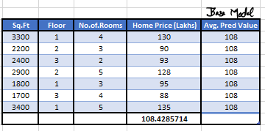
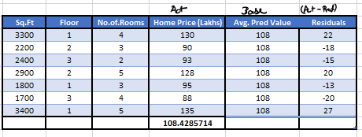
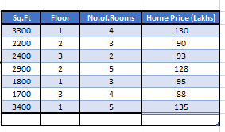
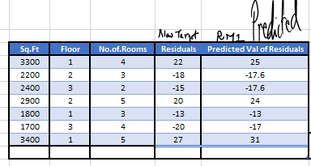
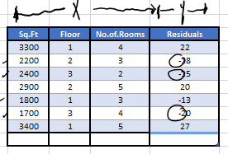

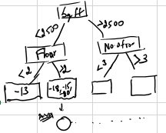
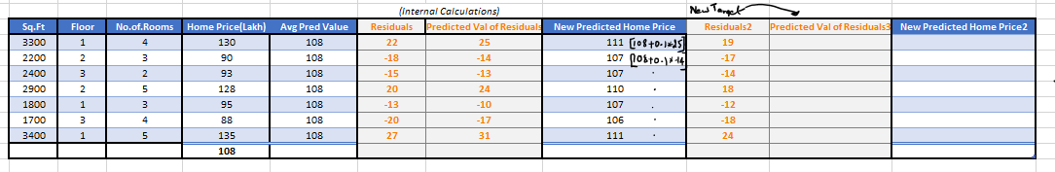
Regression

Slide 30
Extreme Gradient Boosting
Developed in 2014, by deep learning community group
It is an open source software library, compatible with c++, Java, Python, R
Purpose
To increase speed and performance
Done by introducing Regularization – To reduce overfitting
Optimization – To increase accuracy
DT are grown sequentially and learn from the previous iteration
Goal –to minimize the overall score ( impurity in prediction of the DT) composed by the loss function

Slide 31
Advantages
Inbuilt hyperparameter tuning
Efficient in handling missing data (since it uses best hyperparameter)
Regularization for avoiding overfitting
Cache awareness (cache memory)- for computation purpose
Tree is grown till the depth(taken care of regularization)
Parallelized tree building – improve process time
Drawbacks
It is more difficult to understand, visualize and to tune
More hyperparameters should be tweaked to improve accuracy

Slide 32
Steps
Calculate the average of output features
Calculate residuals = actual-average value
Hyperparameter
λ- to control overfitting(prune tree), and outliers (generalize the model)
γ- control overfitting(auto pruning)
Eta- define how fast to converge to the next value (learning rate, default=0.3)
Creating DT based on residuals
Similarity score = ∑ residuals^2/(no.of.residuals+λ) -- calculated at each node
Similarity score is high – same sign of residuals Low – different sign of residuals
Computing gain - (SS after spilt – SS before split)
Define Gamma – default,130
If Gamma>gain, split doesn’t happens
If Gamma<gain, split happens

Slide 33
Get the output = ∑ residuals/(no.of residuals+λ)
New predictions = prev.prediction + (L.R*output)
Residuals(R2) = actual – pred value
Repeat the iteration upto the no.of estimators

Slide 34
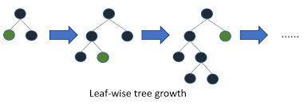
Light Gradient boosting
Developed by Microsoft – April 2017
Lighter version of gradient boosting – more efficient, faster and bit more accurate
Splitting of DT – leaf wise & uses Gini index
7 times faster than XGBOOST
Better approach – dealing with larger data with limited time
Tree splitting technique – GOSS (Gradient based one side sampling) – leaf wise splitting
Inbuilt intelligence to handle the spare dataset (more no of Zeros and less no of ones)
Feature bundling(identifying the possibility of combining one or more feature) – to reduce dimensions to some extent
Overfitting - controlled by defining depth of splitting

Slide 35
Step-1
500k records
490k- correctly classified
10k – misclassified
Step-2
→ 10% of correctly classified – 49k – Larger gradient values (random sampling)
10k misclassified record – lesser gradient values
Step-3
→ The steps are repeated, larger and lesser gradient values gets reduced – and results are achieved

Slide 36
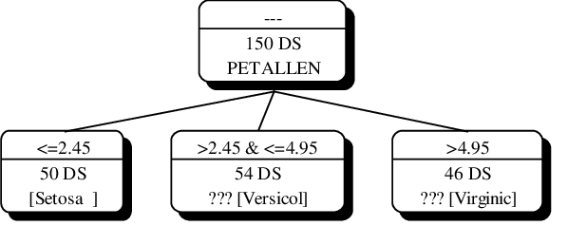
Histogram based approach – tree splitting
Data are arranged in ascending order, and bins are created and based on that the splitting is happened, and hence the process time is reduced
Drawback
When bin size is high – accuracy increased and speed decreases
When bin size is more – accuracy decreased and speed increased
Advantage
Process time decreased (histogram based approach, leaf wise splitting)
Accuracy increased
Can handle spare data
For more accuracy & to deal with overfitting problem
Lesser learning rate, more iteration
Can use GART technique – boosting type
Maximum bin size
Use more data

Slide 37
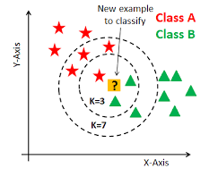
K Nearest Neighbour
Applied for both regression and classification problems
K – represent the no of neighbours used to classify/ predict
Works on the principle of Euclidean distance – distance is calculated between test data and each training data
Based on K value, the similarity between data are taken and by using voting classifier decisions are made.
Drawback
Model except exact data – just looking into similarity score predictions are made
They memorize the pattern instead of learning it, lazy algorithm
KNN is not used if the dataset have high variance

Slide 38
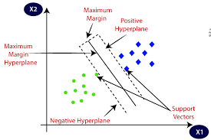
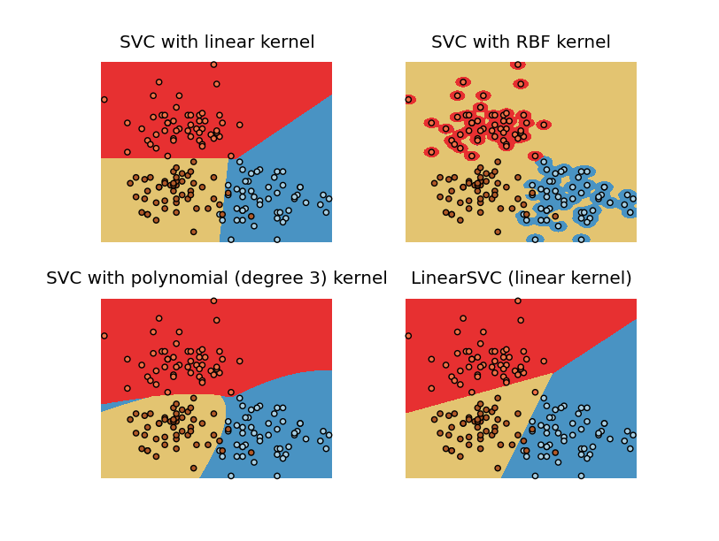
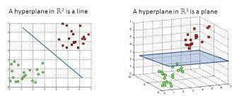
Support vector machine
Highly advanced, stable algorithm
Highly stable algorithm with high precision
Main goal – maximize the margin distance to get better separability
Working with neural network based concept- training time is more
Objective – to find hyperplane in N-dimensional space
Kernel trick – the process of converting non separable data into
Separable form
Linear kernel – Linear
Polynomial kernel - poly
Radial kernel – rbf (radial bases function)
Sigmoid kernel

Slide 39
Terminologies
Support vectors
The points which are passing through the marginal hyperplanes
Hyperplanes
The plane used to divide two or more clauses
Marginal distance
Distance between the 2 parallel lines created w.r.t the most +ve and –ve clauses

Slide 40
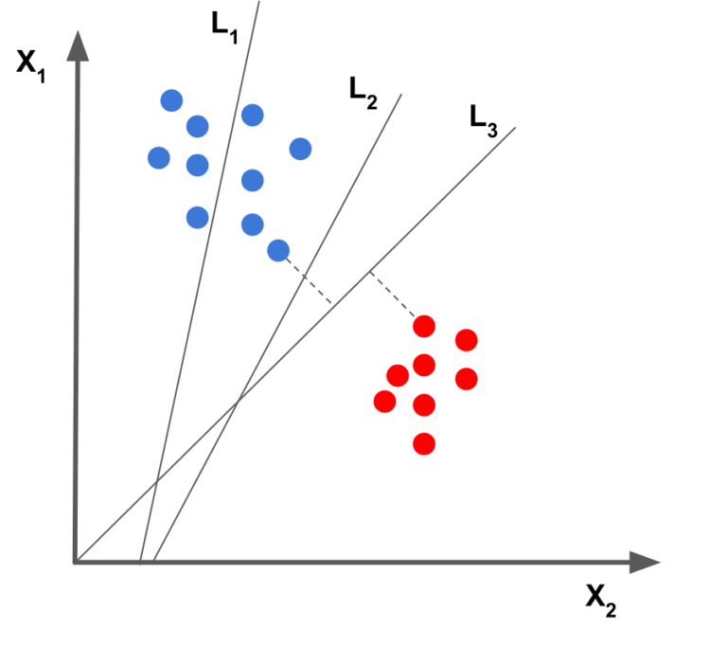
Linearly separable dataset
Can separate the classes by using straight line between classes
wx+b=0(hyperplane)
wx+b=1(+ve hyperplane)
wx+b=-1(-ve hyperplane) – should be satisfied to get better separation – if not, w(weight) & b(bias) are optimized to achieve the condition – the lines get rotated, to find the best fit line
Kernel - linear

Slide 41
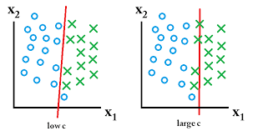
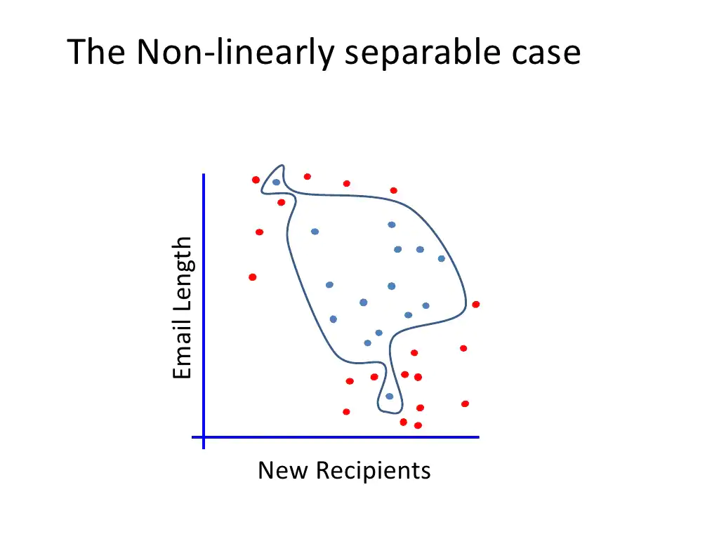
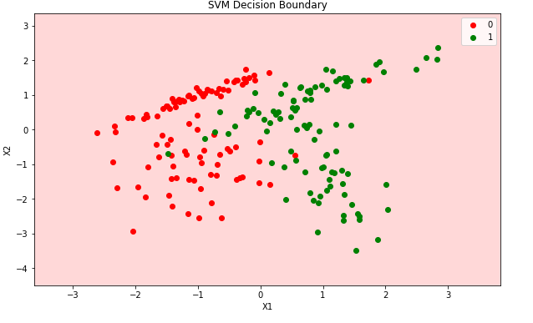
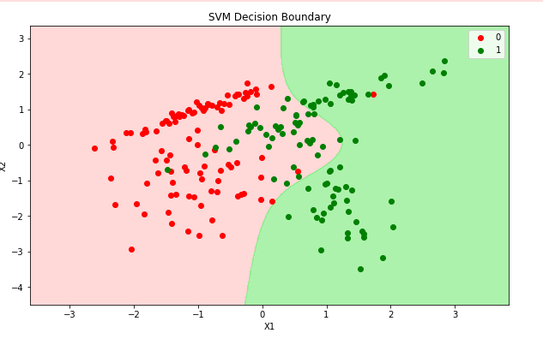
Non linear separable data
Cannot separate the classes by using straight line between classes
Hyperparameter
C- to control error/misclassified points
(small C –lower weightage to misclassified points
large C – higher weightage to misclassified points)
Gamma – the curvature boundary of decision boundary
(low – larger similarity distance, doesn’t capture the shape
high – the points should be close enough , capture shape)

Slide 42
Model Validation techniques
Train test split
K Fold cross validation
Leave one out cross validation

Slide 43
Need
Client won’t give the entire data – trust reason
Therefore, for the data available in the client, the accuracy may differ (usually the accuracy is less due to those unseen value)
In order to predict the correct accuracy we split the data into two parts, one is used for training purpose and another one for testing purpose

Slide 44
Train test split
Here data is divided randomly into two parts for training and testing and accuracy is calculated
K fold cross validation
Data is divided into equal size k subsets called folds
Each fold is considered as a validation set and the rest other folds are a training set
Process is repeated for all the folds and the average accuracy is taken as a overall accuracy
Here, building, training and testing will happen in a single go
Leave one out cross validation
Here at each iteration, out of n records, one record is left as a test data, and accuracy is calculated.
Process is repeated for n times and average accuracy is calculated
Not reliable

Slide 45
Evaluation Metrics in Regression
Evaluation metrics for regression
R2,multiple R2
Adjusted R2
Residual plot
P-value
AIC,BIC
Mean absolute, Mean square error

Slide 46
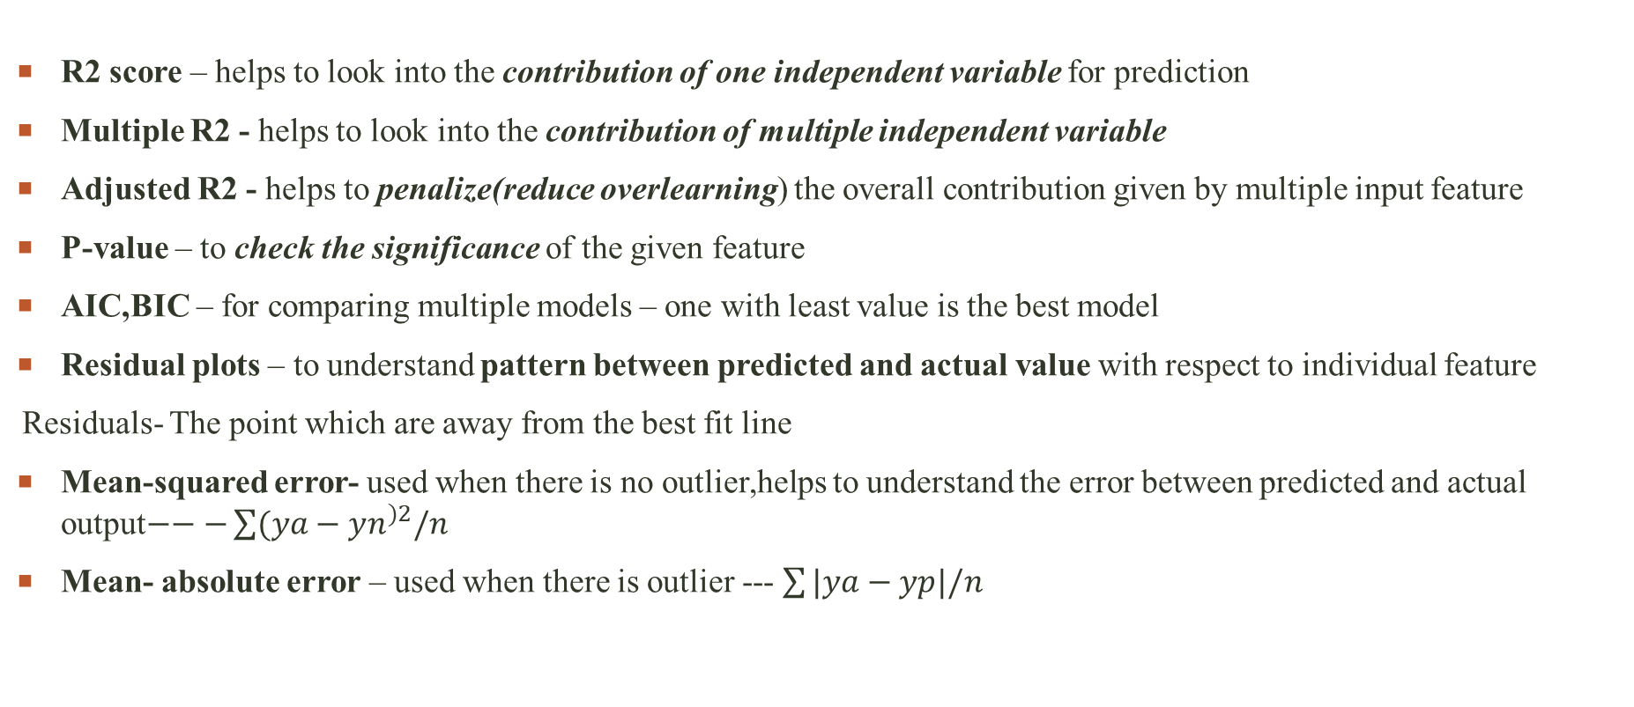
Evaluation Metrics in Regression
R2 score – helps to look into the contribution of one independent variable for prediction
Multiple R2 - helps to look into the contribution of multiple independent variable
Adjusted R2 - helps to penalize(reduce overlearning) the overall contribution given by multiple input feature
P-value – to check the significance of the given feature
AIC,BIC – for comparing multiple models – one with least value is the best model
Residual plots – to understand pattern between predicted and actual value with respect to individual feature
Residuals- The point which are away from the best fit line
Mean-squared error- used when there is no outlier,helps to understand the error between predicted and actual output$−−−\sum{(ya−yn^{)2}/n}$
Mean- absolute error – used when there is outlier --- $\sum{|ya−yp|/n}$

Slide 47
Evaluation metrics for Classification
Evaluation Metrics for classification
Confusion matrix
Precision and recall
Accuracy
F1 score
AUC
ROC

Slide 48
Evaluation metrics for Classification
Confusion matrix- helps to understand the misclassification counts done by the model
Precision – it speaks about individual class stability (column wise)
Precision at 1 -- TP/(TP+FP), Precision at 0 – TN/(FN+TN)
Recall – it speaks about individual class accuracy (row wise)
Recall at 1 -- TP/(TP+FN), Recall at 0 – TN/(FP+TN)
Precision ≈ Recall(Trade off between them)
Accuracy–Gives overall accuracy of the model (TP+TN)/(TP+TN+FP+FN)
F1- score – it is more stable than accuracy, because it involves both recall and precision.
F1 score – 2*(precision*recall)/(precision + recall) – harmonic mean
ROC – It speaks about probability of how well my model gonna behave in the real world.
TPR vs FPR – Ideal expectation TPR=100% and FPR=0%
ROC curve-probability curve-sigmoid curve
AUC – it speaks about separability (separability between class)
AUC close to 1 – good model, AUC close to 0 – poor model
 | 1 | 0
1 | TP | FN
0 | FP | TN

Slide 49
Clustering
For non- specific outputs
Need – For 2D dataset, humans and group easily but for higher dimension(feature) , machine learning algorithms are used
Steps
Grouping – similar items get into one group and each groups are different from one another
Training
Testing
Evaluation
Purpose
Segregating the data into several groups for making decision

Slide 50
Types of clustering
Hierarchal/agglomerate clustering – Bottom up approach
K Means clustering – Top down approach
DBSCAN clustering

Slide 51
Hierarchal/Agglomerate clustering
Steps
Distance metrics (Euclidian distance) is calculated between the each points.
Euclidian distance - d = √[(x₂ – x₁)² + (y₂ – y₁)²] – shortest route posible –preferred one
Manhattan distance – d= |X1 – X2| + |Y1 – Y2| - longest route
Combine one record with another cluster
Max (d1,d2,d3) – complete linkage
Min (d1,d2,d3) – single linkage
Avg (d1,d2,d3) – average linkage

Slide 52
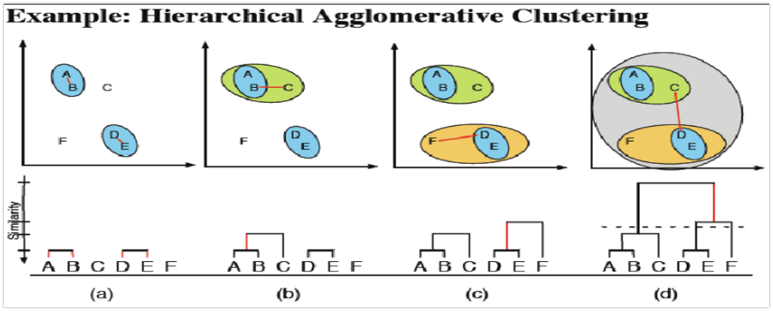
Finding distance → tweaking linkage → points are combined(cluster) → cluster with points → cluster with another cluster → then forms a whole group
Dendogram – helps to find the architecture of how clustering is made

Slide 53
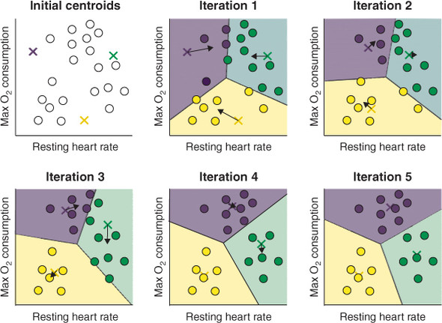
K Mean Clustering
Steps
Define K value – no of clusters – the entire dataset is
divided based on K value, by tweaking K value better accuracy
can be obtained(Elbow method can be used)
Centroid for each group is calculated
Distance of the point from the centroid is computed
The data points are moved to the nearest centroidal cluster
Due to repositioning the centroid is computed once more
The process is repeated until repositioning doesn’t happens
Goal – All the points should have minimum distance from the cluster centroid

Slide 54
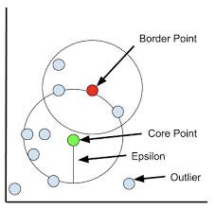
DBSCAN clustering
Density Based Spatial Clustering of Association with Noise
Radius of the neighbourhood (R) – that if include enough no of points within which we call it as a dense area
Minimum no of neighbourhood (M) – Minimum number of point we need to form a cluster
E.g. R=2,M=5, expecting 5 points to be present within 2 units of radius
Each points present are classified as
Core points
Border points
Outlier points
Advantage
Arbitrarily shaped cluster
Robust to outlier
Doesn’t require specification

Slide 55
Association rule
Study of what goes with what (frequent items sales hand in hand)
Also called as affinity analysis/market based analysis
E.g. Dependency between purchase of different items
Rule form
Antecedent → consequent (support, confidence) e.g., bread → jam, bread → milk
Association rule type
Actionable rule – high quality, actionable information - recommended
Trivial rule – information already known by the client – not recommended
Inexplicable rule – no explanation and with no action - not recommended

Slide 56
Steps
Generate most frequently occurred item sets – Apriori algorithm
For K products, set support criterion
Association rules
Support = (no.of transactions involved in 1 or n products) / Total number of transaction
Generate list of one item set that meets the support criterion
Use list of one item set to generate two item next two set to three, and continue for k items set which meets the support criterion
Confidence = (no.of transactions involved in 1 or n products) / Total no of transaction with antecedent
Generate the list of items meets the confidence criterion and the steps are repeated as of support
Lift ratio = (how dependent)/independent – dependence score, L.R>1(best)
Helps to understand the dependency of an item with other items

Slide 57
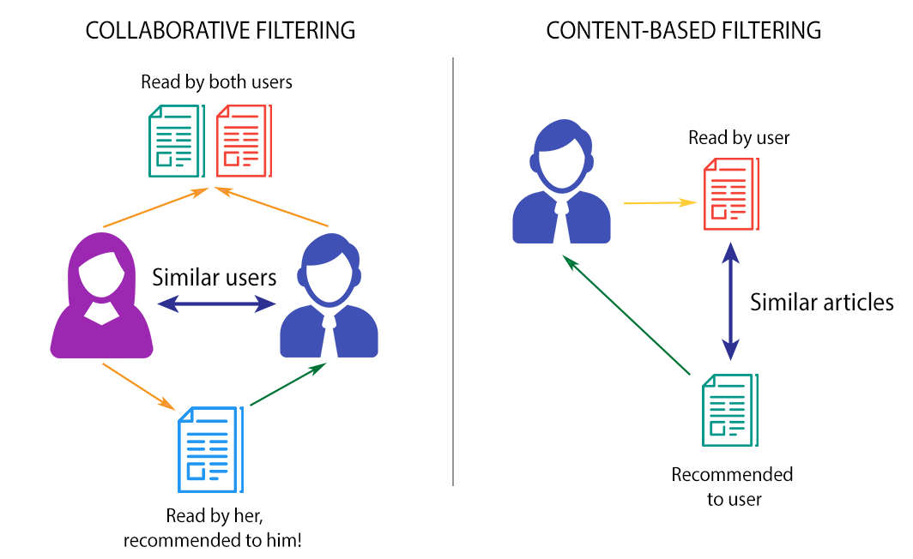
Recommendation Engines
It will recommend the most relevant items to a particular user or customer
Types
Popularity based – principle – popularity ( recommend
the one which is in trend)
Content based – principle – item feature to recommend
other item (eg: comedy movies) – single users

Slide 58
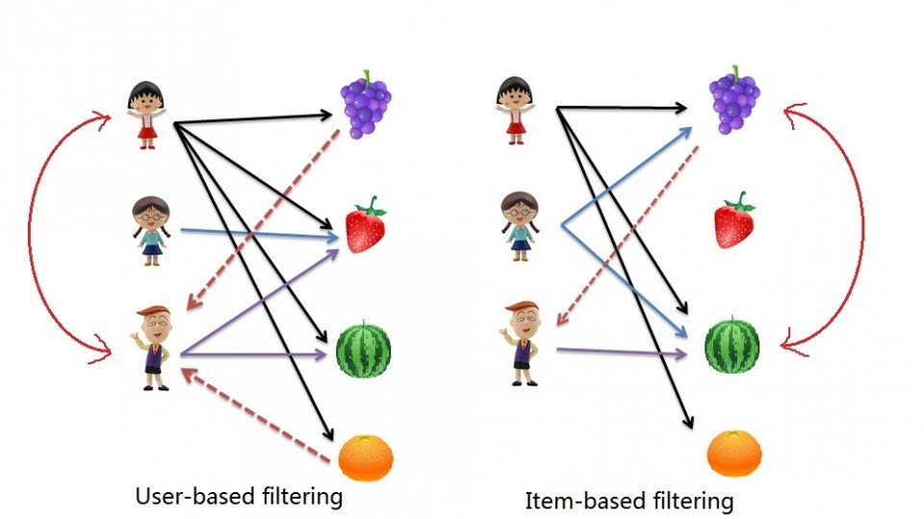
Collaborative
Item to item based
matching preferences of multiple users
(e.g., matching thriller movies watched by one user
with another user who preferred the same)
User to user based
measures similarity between the users
(e.g., matching the movies watched by a
person with another user)
Hybrid based – combines item to item based and user to user based

Slide 59
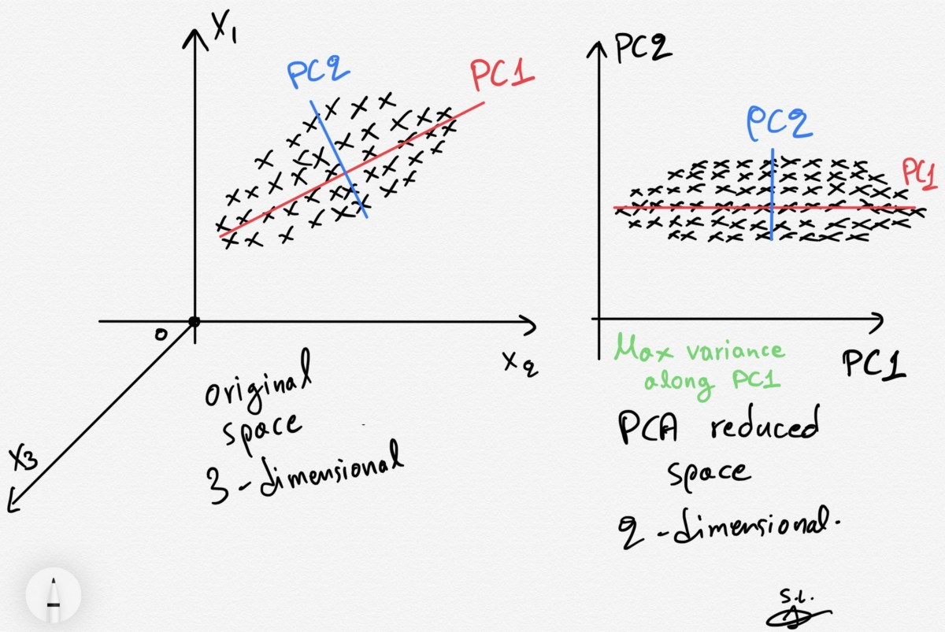
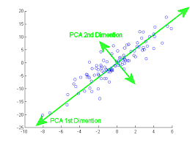
Principle component Analysis
Helps to reduce features – helps for better visualization features in 2D
Useful while dealing with high dimensional data
Primary goal is to reduce the dimension of the feature
than visualization
Concept
A straight line is taken, and the data points are projected on to
the straight line so that the straight line will occupy most of the
information
The math behind this process includes eigen vectors
and weighted average of original columns

Slide 60
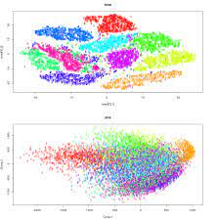
t SNE
Primary goal is visualization by preserving the original structure
than dimensionality reductions
Mostly used to understand and visualize high dimensional data
by projecting it in a low dimensionality space with the help of
conditional probability on linearly non separable data points
Similar points are modelled as nearby points
Dissimilar points are modelled as distant points
Name explanation
Stochastic – probability distribution
Neighbour – nearby points
Embedded – projecting points from higher dimension to lower dimension
t- in order prevent crowding problem, the data points are projected into the t distribution curve to get a space

Slide 61
Uses - helps to separate the data which are not separate by the straight line
Three stages in t SNE
Construct the probability distribution over the pair of high dimensional points
Similar points – higher probability
Dissimilar points - lower probability
It gives similar probability distribution over the points in lower dimensions
It minimizes the KL divergence between the two distribution w.r.to the location of points in the map

Slide 62
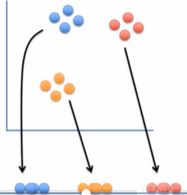
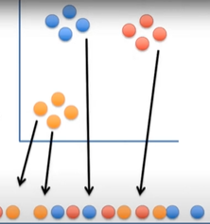
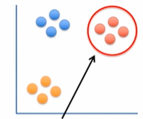
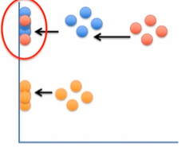

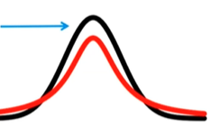
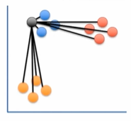
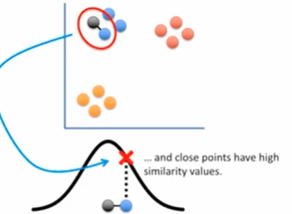
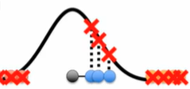

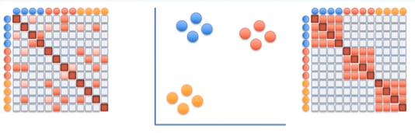

Slide 63
The data which we need to project in single dimension
Projecting the data into anyone on of the axis, we end up with a big mess – no original shape
The points are moved by multiple attraction(similar points/close to each other in 2D) and repulsion(dissimilar points)
Steps
One point is selected and the distance between the selected points with other points are calculated
Then the distance is plotted on the normal distribution curve, with centre as a selected point
Then draw a line to the curve – length is the unscaled similarity(close points have high similarity, distance points have low similarity)
The similarity scored are scaled – since the width curve is less for closely packed data and wide for loosely packed data – scaled similarity helps to over this problem

Slide 64
Then the similarity distance between the points in a number line is calculated, the distance are projected on the t distribution curve – unscaled similarity are measured and after that they were scaled
Hence by comparing the similarity score obtained for the original data, the points in the number line are moved slowly
The points are clump up in the middle if t curve is not used

